Slide 1
Lecture 2: Neural Networks; Design and Regularization

Slide 2
Outline
First build a network/
- First explain the basic things of a NN input layer, hidden layer, output layer, activation function , loss function
- Show how forward works
Show an example of a a complicated functions and show how it works by adding nodes and layers
Conclude with a function approximation f(x) -> y
Show a network that it can not get it right because of the output layer and explain the basic output layers
Linear
Logistic
Show a network and emphasize on the last results. Show an example where the output is incorrect ….type (0,1, … ) so we need
Design Choices
Look inside

Slide 3
Anatomy of artificial neural network (ANN)
neuron
node
input
output
X
Y

Slide 4
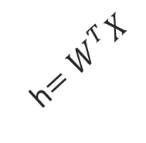
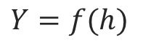
Anatomy of artificial neural network (ANN)
neuron
node
input
output
Affine transformation
$$Y=f(h)$$
Activation
X
Y
h$=W^{T}X$
We will talk later about the choice of activation function. So far we have only talked about sigmoid as an activation function but there are other choices.

Slide 5

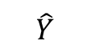
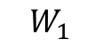
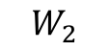
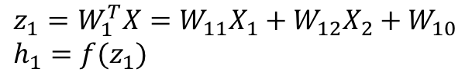
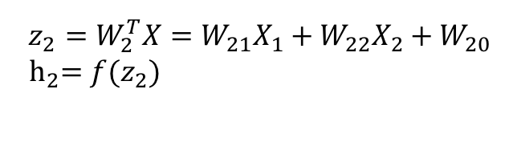
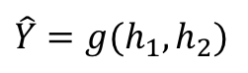
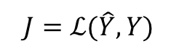
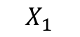
Anatomy of artificial neural network (ANN)
Input layer
hidden layer
output layer
$$z_{1}=W_{1}^{T}X=W_{11}X_{1}+W_{12}X_{2}+W_{10} \\ h_{1}=f(z_{1})$$
$$X_{1}$$
$$W_{1}$$
$$\hat{Y}$$
$$\hat{Y}=g(h_{1},h_{2})$$
$$J=ℒ(\hat{Y},Y)$$
Output function
Loss function
$$X_{2}$$
$$W_{2}$$
$$z_{2}=W_{2}^{T}X=W_{21}X_{1}+W_{22}X_{2}+W_{20}$$
$${ h}_{2}=f(z_{2})$$
We will talk later about the choice of the output layer and the loss function. So far we consider sigmoid as the output and log-bernouli.

Slide 6
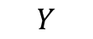
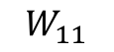
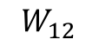
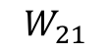
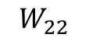
Anatomy of artificial neural network (ANN)
Input layer
hidden layer 1
hidden layer 2
output layer
$$X_{1}$$
$$W_{11}$$
$$W_{21}$$
$$Y$$
$$X_{2}$$
$$W_{12}$$
$$W_{22}$$

Slide 7
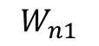
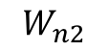
Anatomy of artificial neural network (ANN)
Input layer
hidden layer 1
hidden layer n
output layer
$$X_{1}$$
$$W_{11}$$
…
$$W_{n1}$$
$$Y$$
$$X_{2}$$
$$W_{12}$$
…
$$W_{n2}$$
We will talk later about the choice of the number of layers.

Slide 8
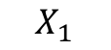
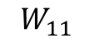
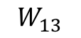
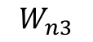
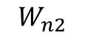
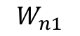
Anatomy of artificial neural network (ANN)
Input layer
hidden layer 1, 3 nodes
hidden layer n
3 nodes
output layer
$$W_{n1}$$
$$W_{11}$$
$$X_{1}$$
$$W_{12}$$
…
$$W_{n2}$$
$$Y$$
$$X_{2}$$
$$W_{13}$$
$$W_{n3}$$

Slide 9
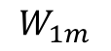
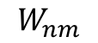
Anatomy of artificial neural network (ANN)
Input layer
hidden layer 1,
hidden layer n
output layer
m nodes
$$W_{n1}$$
$$W_{11}$$
$$X_{1}$$
m nodes
…
…
$$Y$$
$$X_{2}$$
$$W_{1m}$$
$$W_{nm}$$
We will talk later about the choice of the number of nodes.

Slide 10
Anatomy of artificial neural network (ANN)
Input layer
hidden layer 1,
hidden layer n
output layer
m nodes
$$W_{n1}$$
$$W_{11}$$
$$X_{1}$$
m nodes
Number of inputs d
…
…
$$Y$$
$$X_{2}$$
$$W_{1m}$$
$$W_{nm}$$
Number of inputs is specified by the data

Slide 11
Design Choices
Activation function
Loss function
Output units
Architecture
Optimizer

Slide 12
Design Choices
Activation function
Loss function
Output units
Architecture
Optimizer

Slide 13
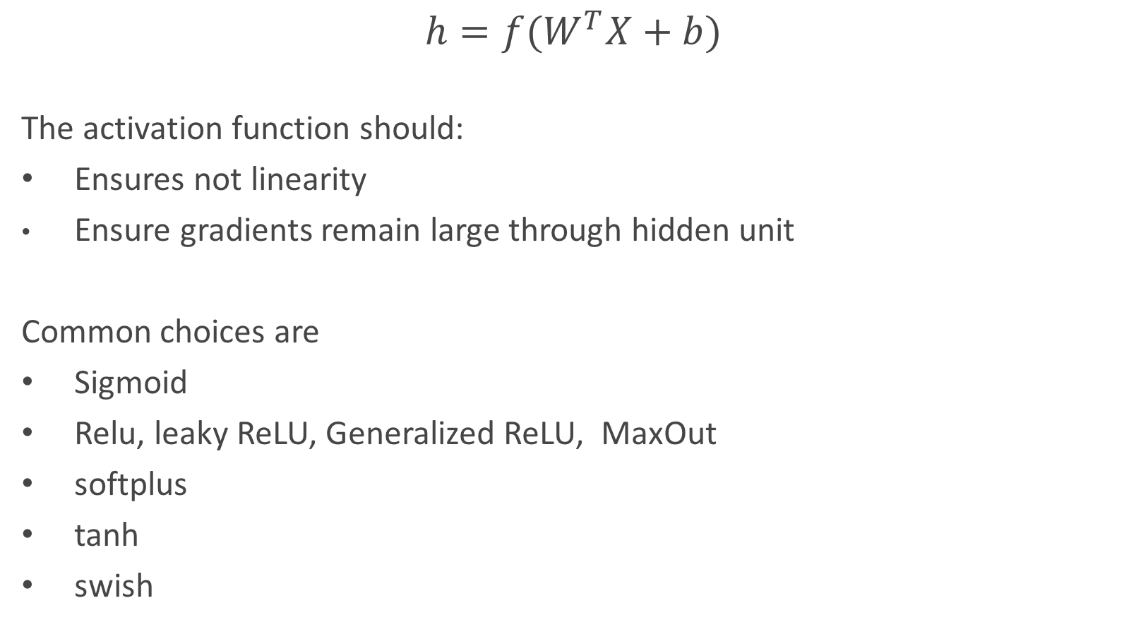
Activation function
$$h=f(W^{T}X+b)$$
The activation function should:
Ensures not linearity
Ensure gradients remain large through hidden unit
Common choices are
Sigmoid
Relu, leaky ReLU, Generalized ReLU, MaxOut
softplus
tanh
swish

Slide 14
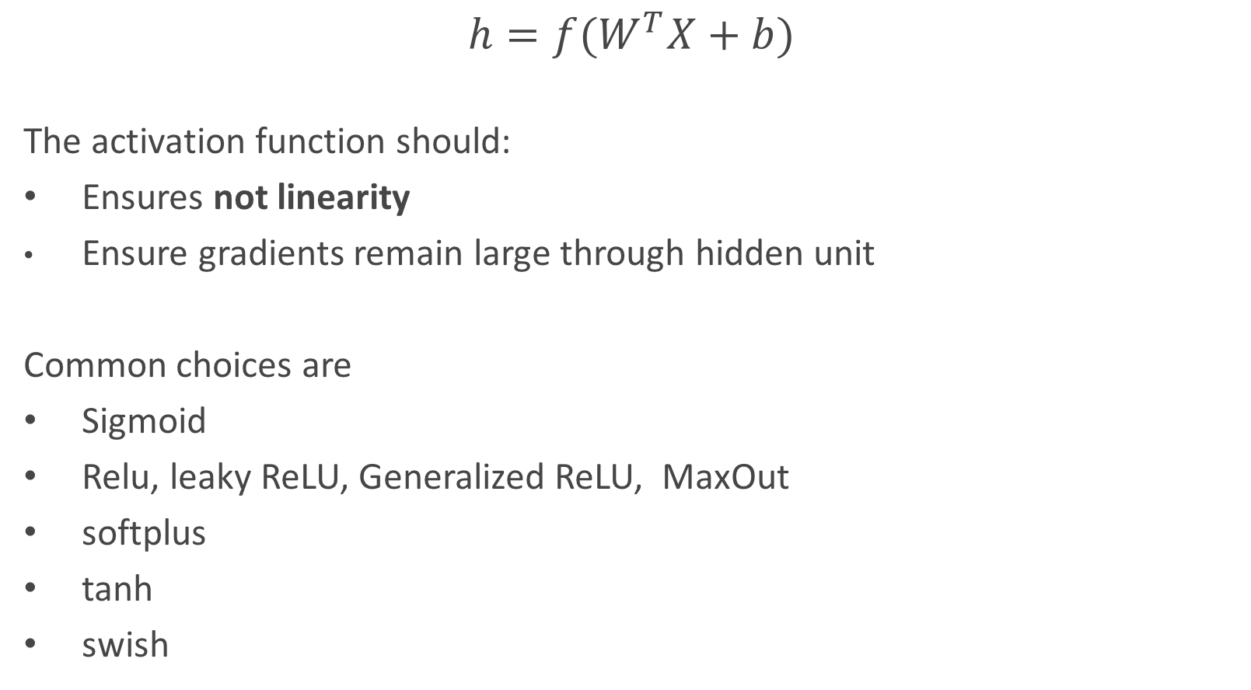
Activation function
$$h=f(W^{T}X+b)$$
The activation function should:
Ensures not linearity
Ensure gradients remain large through hidden unit
Common choices are
Sigmoid
Relu, leaky ReLU, Generalized ReLU, MaxOut
softplus
tanh
swish

Slide 15
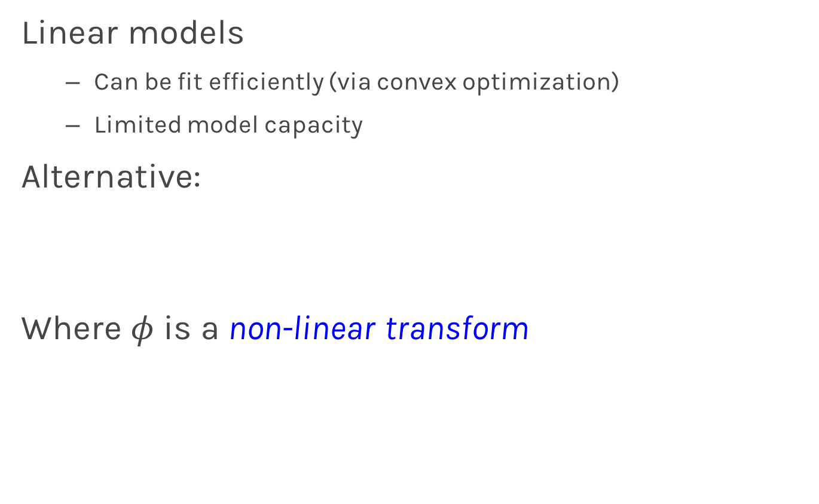
Beyond Linear Models
Linear models
Can be fit efficiently (via convex optimization)
Limited model capacity
Alternative:
Where $φ$ is a non-linear transform

Slide 16
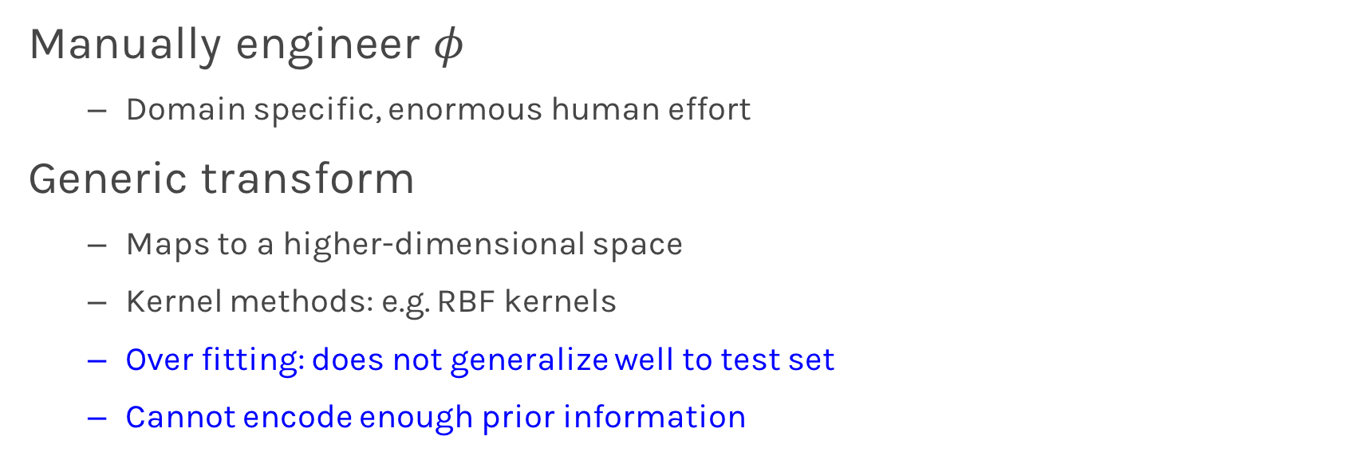
Traditional ML
Manually engineer $φ$
Domain specific, enormous human effort
Generic transform
Maps to a higher-dimensional space
Kernel methods: e.g. RBF kernels
Over fitting: does not generalize well to test set
Cannot encode enough prior information

Slide 17
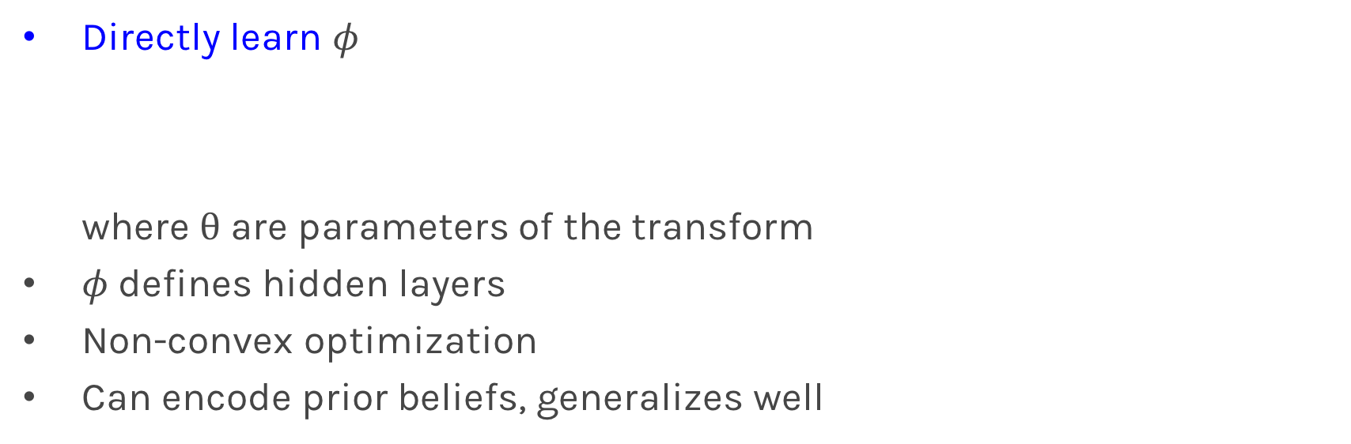
Deep Learning
Directly learn $φ$ where $θ$ are parameters of the transform
$φ$defines hidden layers
Non-convex optimization
Can encode prior beliefs, generalizes well

Slide 18
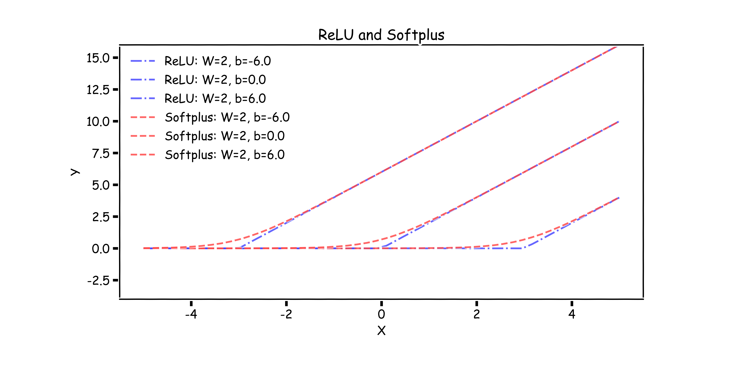
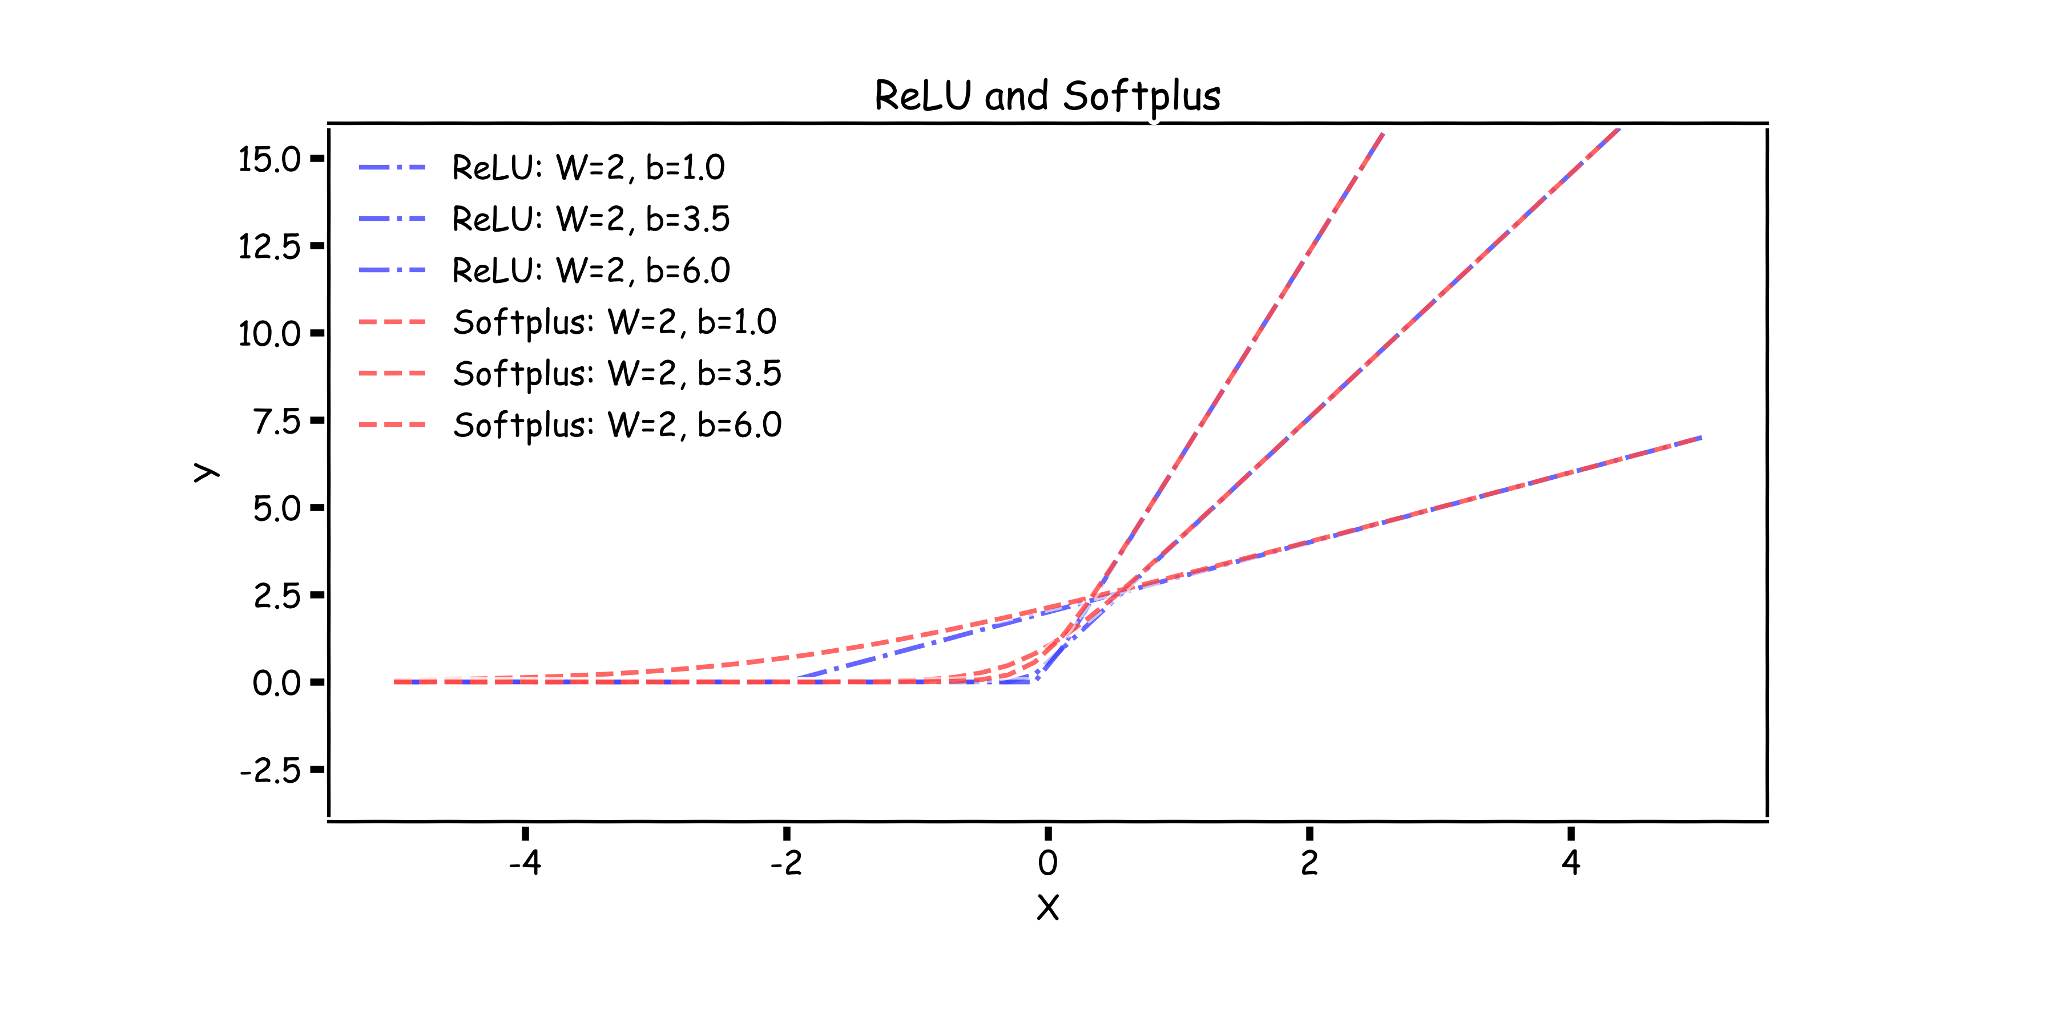
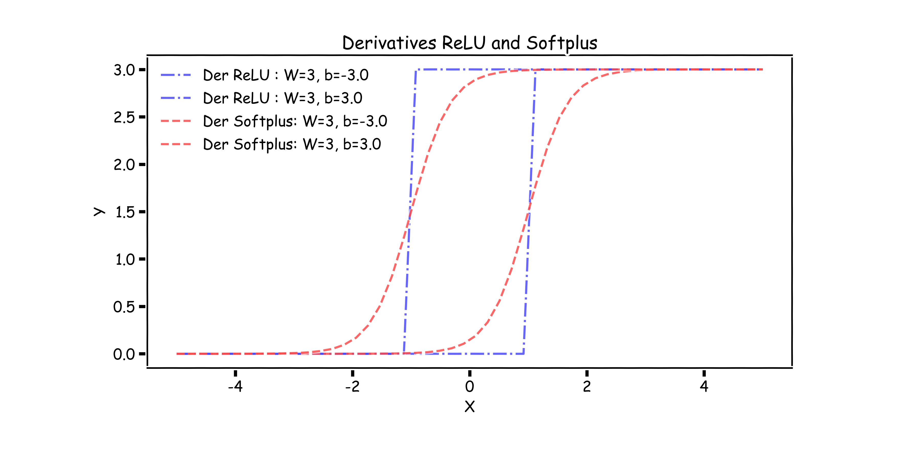
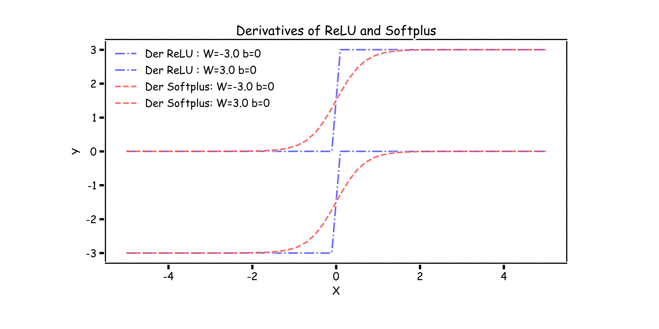
Relu and Softplus
-b/W

Slide 19
Sigmoid and tanh

Slide 20
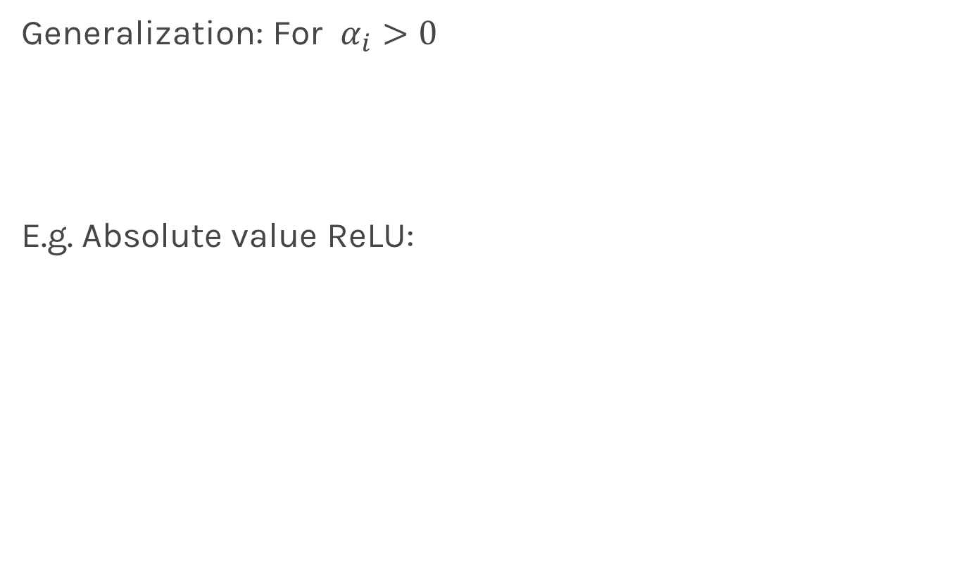
Generalized ReLU
Generalization: For $α_{i}>0$
E.g. Absolute value ReLU:
0

Slide 21
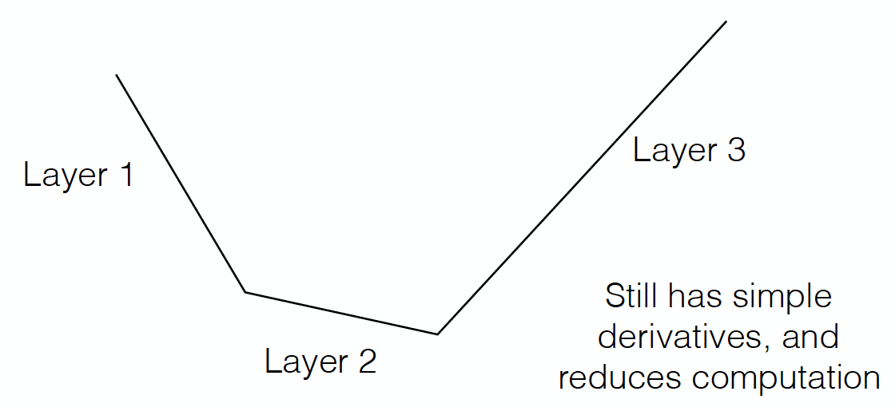
Maxout
Directly learn the activation function
Max of k linear functions
(α₁, β₁)
(α₃, β₃)
Line 3
(α₂, β₂)

Slide 22
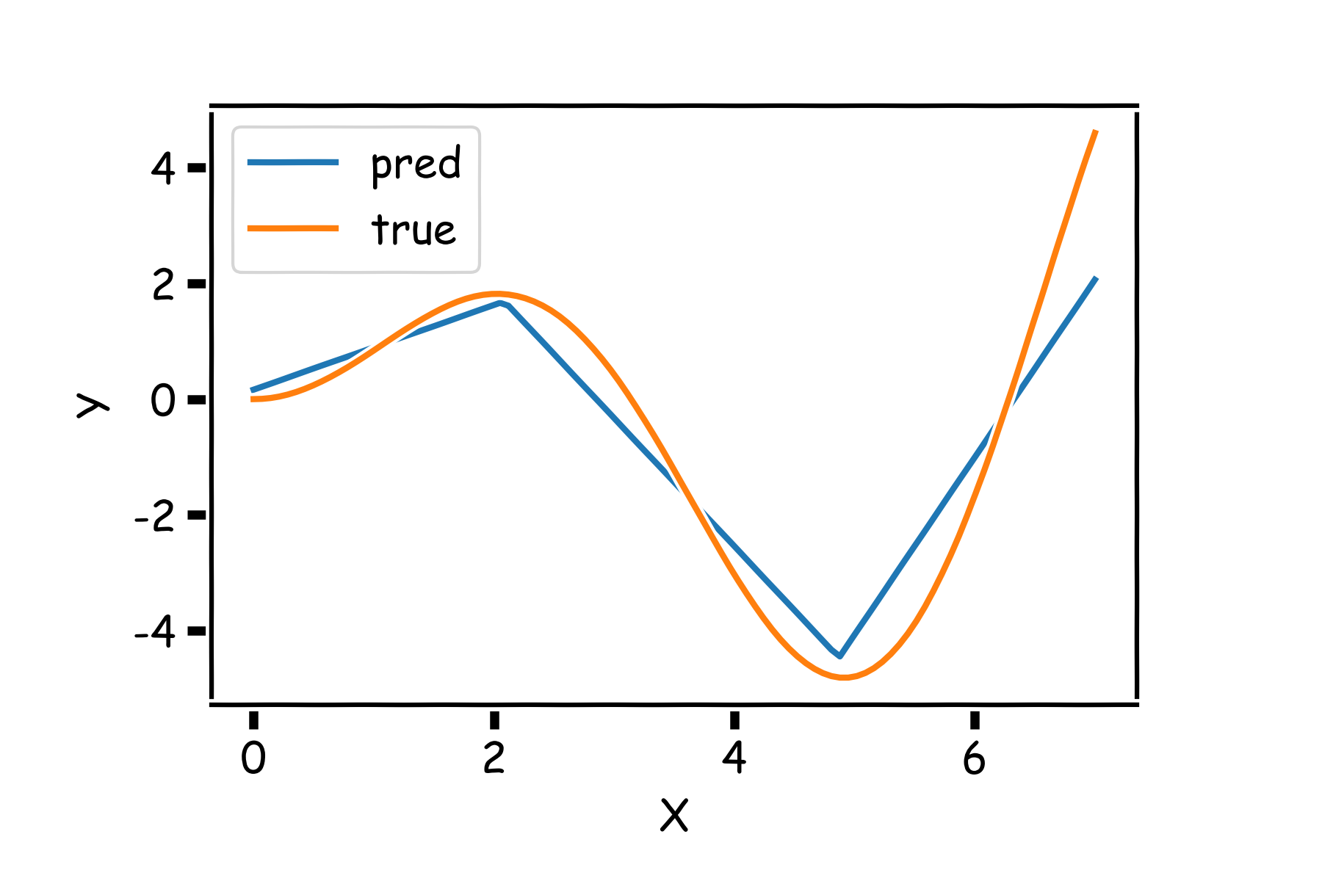
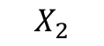
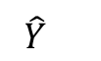
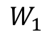
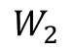
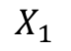
NN in action. Some examples
$$X_{1}$$
$$W_{1}$$
$$\hat{Y}$$
$$X_{2}$$
$$W_{2}$$

Slide 23
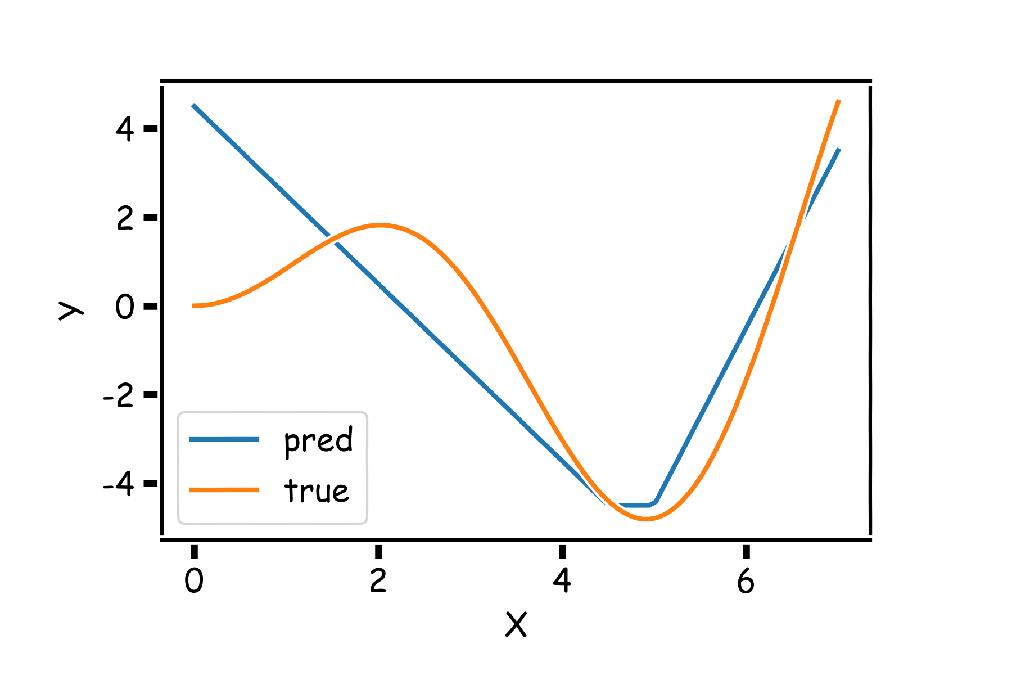
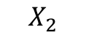
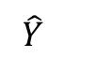
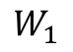
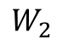
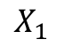
NN in action. Some examples
$$X_{1}$$
$$W_{1}$$
$$\hat{Y}$$
$$X_{2}$$
$$W_{2}$$

Slide 24
Design Choices
Activation function
Loss function
Output units
Architecture
Optimizer

Slide 25
Output Units
Output Type | Output Distribution | Output layer | Cost Function
Binary
(Goodfellow 2017)

Slide 26
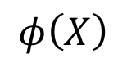
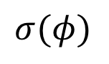

Link function
$$X⟹φ\left(X\right)=W^{T}X⟹P\left(y=0\right)=\frac{1}{1+e^{φ(X)}}$$
X
Y
OUTPUT UNIT
X
$$φ\left(X\right)$$
$$σ(φ)$$
Y

Slide 27
Output Units
Output Type | Output Distribution | Output layer | Cost Function
Binary | Bernoulli | Sigmoid | Binary Cross Entropy
(Goodfellow 2017)

Slide 28
Output Units
Output Type | Output Distribution | Output layer | Cost Function
Binary | Bernoulli | Sigmoid | Binary Cross Entropy
Discrete
(Goodfellow 2017)

Slide 29


Link function multi-class problem
X
Y
OUTPUT UNIT
X
$$\vec{φ}(X)$$
$$SoftMax$$
Y

Slide 30
Output Units
Output Type | Output Distribution | Output layer | Cost Function
Binary | Bernoulli | Sigmoid | Binary Cross Entropy
Discrete | Multinoulli | Softmax | Cross Entropy
(Goodfellow 2017)

Slide 31
Output Units
Output Type | Output Distribution | Output layer | Cost Function
Binary | Bernoulli | Sigmoid | Binary Cross Entropy
Discrete | Multinoulli | Softmax | Cross Entropy
Continuous | Gaussian | Linear | MSE
(Goodfellow 2017)

Slide 32
Output Units
Output Type | Output Distribution | Output layer | Cost Function
Binary | Bernoulli | Sigmoid | Binary Cross Entropy
Discrete | Multinoulli | Softmax | Cross Entropy
Continuous | Gaussian | Linear | MSE
Continuous | Arbitrary | - | GANS
(Goodfellow 2017)

Slide 33

Representation
Representation Matters

Slide 34

Learning Multiple Components
(Goodfellow 2016)

Slide 35

Depth = Repeated Compositions

Slide 36

Neural Networks
Hand-written digit recognition: MNIST data

Slide 37

Cost Function
Cross-entropy between training data and model distribution (i.e. negative log-likelihood)
Do not need to design separate cost functions
Gradient of cost function must be large enough

Slide 38

Cost Function
Example: sigmoid output + squared loss
Flat surfaces

Slide 39

Cost Function
Example: sigmoid output + cross-entropy loss
log undoes exp
Saturates only when the model makes correct predictions

Slide 40
Design Choices
Cost function
Output units
Hidden units
Architecture
Optimizer

Slide 41
Design Choices
Cost function
Output units
Hidden units
Architecture
Optimizer

Slide 42

Universal Approximation Theorem
One hidden layer is enough to represent an approximation of any function to an arbitrary degree of accuracy
So why deeper?
Shallow net may need (exponentially) more width
Shallow net may overfit more

Slide 43

Better Generalization with Depth
(Goodfellow 2017)

Slide 44

Large, Shallow Nets Overfit More
(Goodfellow 2017)

Slide 45
Design Choices
Cost function
Output units
Hidden units
Architecture
Optimizer

Slide 46
Gradient-based Optimizer (e.g. stochastic gradient descent)
“Chain rule” for computing gradients:
For deeper networks
Naïve computation takes exponential time

Slide 47
Backpropagation
Avoids repeated sub-expressions
Uses dynamic programming (table filling)
Trades-off memory for speed

Slide 48
Backprop: Arithmetic
Jacobian-gradient products
grad w.r.t. x
Jacobian of ‘g’
grad w.r.t. z
Apply recursively!

Slide 49

Backprop: Overview
Forward prop: compute activations
Compute loss
Back-prop: compute derivatives

Slide 50
Backprop: Example
Linear activation functions
No bias
Squared loss

Slide 51
Backprop: Example
Forward prop: Propagate activations to output layer

Slide 52
Backprop: Example
Backward prop: Compute loss and its derivative

Slide 53
Backprop: Example
Backward prop: Compute derivatives w.r.t. weights c₁ and c₂

Slide 54
Backprop: Example
Backward prop: Compute derivatives w.r.t. weights c₁ and c₂

Slide 55
Backprop: Example
Backward prop: Propagate derivative to hidden layer

Slide 56
Backprop: Example
Backward prop: Compute derivatives w.r.t. weights a₁, a₂, b₁ and b₂

Slide 57
Backprop: Example
Backward prop: Compute derivatives w.r.t. weights a₁, a₂, b₁ and b₂

Slide 58
Backprop: Example

Slide 59

Computation Graphs
(Goodfellow 2017)

Slide 60

Repeated Sub-expressions
(Goodfellow 2017)

Slide 61
Backprop on Computation Graph
Maintain grad table
Parents of u^{i}

Slide 62
Symbol-to-symbol Differentiation
Derivatives as computation graphs
Same language for both forward and back-propagation
During execution, replace symbolic inputs with numeric value
Used by Theano and TensorFlow
Symbol-to-number differentiation: e.g. Torch and Caffe

Slide 63

Symbol-to-symbol Differentiation
(Goodfellow et al. 2017)

Slide 64

Training Feed-forward Nets
Computational cost for forward/back prop: O(#num-weights)
Memory cost:
O(#num-layers x minibatch-size)
(Goodfellow et al. 2017)

